Slide 1

Impact of Car Features
PROJECT REPORT BY : J.ATHREYA SHARMA

Slide 2
Cleaning data
I have cleaned the data by using the pivot table and removed the null values . The given data contained 11915 columns and 16 rows.(ref link is given data )
After cleaning the data contained is 11812 columns and 16 rows you can see the ref link is cleaned data .

Slide 3

Tasks: Analysis

Slide 4
TASK 1:- How does the popularity of a car model vary across different market categories?
PROJECT DESCRIPTION:- The tasks are given to Task 1.A:Create a pivot table that shows the number of car models in each market category and their corresponding popularity scores.
Task 1.B: Create a combo chart that visualizes the relationship between market category and popularity.
Approach:- After cleaning the data I have used the pivot table to perform the task 1 i.e I have taken the market category in the rows model column in the values and I have used the value field for the count. For the popularity column I have used the average value field. For the three columns I drawn a graph .
Tech-Stack Used: I have used Ms office 365 / google sheets for solving the task1.
Insight: I have learned the use of pivot table . A pivot table is a powerful data analysis tool used in spreadsheet programs, such as Microsoft Excel, Google Sheets, or other similar software. It allows you to summarize and analyze large datasets, extract meaningful insights, and present them in a clear and organized manner. Here are some key points about the use of pivot tables:

Slide 5
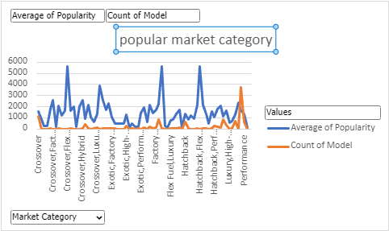
Result:-popular market category (sheet link)

Slide 6

Task 2:-What is the relationship between a car's engine power and its price?
Project Description:-The task is given to Create a scatter chart that plots engine power on the x-axis and price on the y-axis. Add a trendline to the chart to visualize the relationship between these variables.
Approach:- I have used the pivot table in rows I dropped the engine h p and in values column I have dropped msrp for that I have used the filed as sum . And I drawn the scatterplot graph.
Tech stack used:- I have used Ms office 365/ google sheets to perform the operation.
Insights:- The insights from the scatter plot analysis of the relationship between a car's engine power and its price can vary depending on the specific data and patterns observed. I have found the positive correlation.

Slide 7
Result:-car engine vs power (sheet link)
You can find the outlier at the 12000000

Slide 8
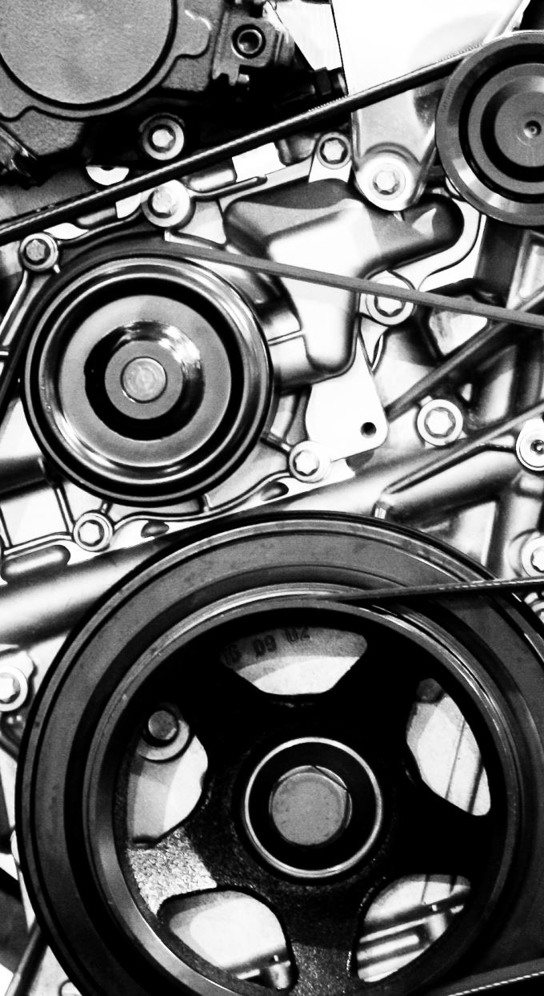
Task 3:-Which car features are most important in determining a car's price?
Project Description:- The task is Using regression analysis to identify the variables that have the strongest relationship with a car's price. Then create a bar chart that shows the coefficient values for each variable to visualize their relative importance.
Approach:- here I have taken the 4 columns named as engine hp, engine cylinders, number of doors, highway mpg, city mpg and msrp with the help of these 4 columns I have calculated the Regression Statistics , An ova and I have calculated the Residual output and probability output for the whole data . Now I have calculated the coefficients of the engine hp, engine cylinders, number of doors, highway Mpg and city Mpg then I have drawn the graph .

Slide 9

Continue
Tech stack used:- I have used Ms office 365/ google sheets to perform the operation.
insights:-The insights derived from the regression analysis and the bar chart of coefficient values can provide valuable information about the variables that have the strongest relationship with a car's price.
Result:- Regression Analysis (sheet link)

Slide 10
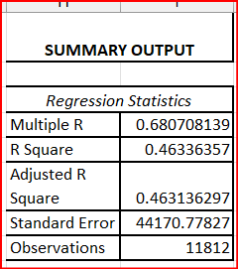
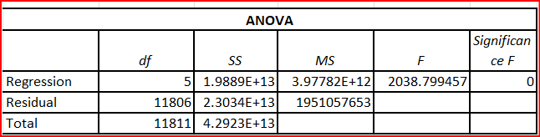
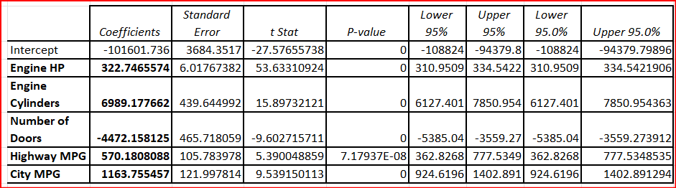
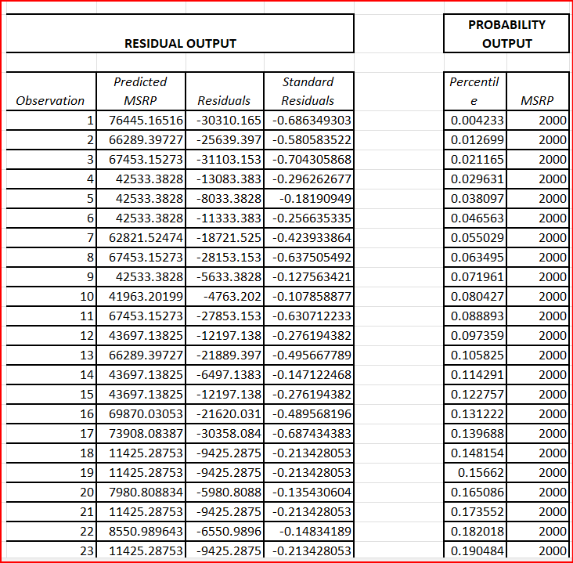

Slide 12
Task 4:-How does the average price of a car vary across different manufacturers?
Project description:- The is given to Task 4.A: Create a pivot table that shows the average price of cars for each manufacturer.
Task 4.B: Create a bar chart or a horizontal stacked bar chart that visualizes the relationship between manufacturer and average price.
Approach:- First of all by using the pivot table I have taken make in the rows column and in the value I have msrp column and I have counted it’s average and I have formatted the decimal value to 0 digit to show the graph accurately.

Slide 13

Continue
Tech stack used:- I have used Ms office 365/ google sheets to perform the operation.
insights:-These insights can help manufacturers, marketers, and decision-makers understand the relationship between manufacturer and average price, make informed pricing strategies, and position their products effectively in the market.
Result:- Average price of car (sheet link)

Slide 15
Task 5:-What is the relationship between fuel efficiency and the number of cylinders in a car's engine?
Project description:- The Task 5.A: Create a scatter plot with the number of cylinders on the x-axis and highway MPG on the y-axis. Then create a trendline on the scatter plot to visually estimate the slope of the relationship and assess its significance.
Task 5.B: Calculate the correlation coefficient between the number of cylinders and highway MPG to quantify the strength and direction of the relationship.
Approach:- I have take two columns from the data set named as engine cylinder and highway mpg and selected the two columns entire data and drawn the scatter plot graph. After that I have found the correlation coefficient using the formula =CORREL(A2:A11813,B2:B11813).

Slide 16
Continue
Tech stack used:- I have used Ms office 365/ google sheets to perform the operation.
insights:- The insights that can be derived from the scatter plot with a trendline of the relationship between the number of cylinders and highway MPG are Direction of the relationship, Strength of the relationship, Outliers , Trendline significance , Interpretation of the slope , Consideration of other factors
Result:- fuel efficiency (sheet link)

Slide 17
correlation coefficient= -0.620312551

Slide 18
Building the Dashboard

Slide 19
Task 1: How does the distribution of car prices vary by brand and body style?
Project description:- The task is given to find how does the distribution of car prices vary by brand and body style
Approach:- I have taken make in the axis column and sum of msrp in the values and vehicle style in the legend. Now , by using this data I have founded the graph .
Tech stack used:- I have used Ms office 365/ google sheets to perform the operation.

Slide 20
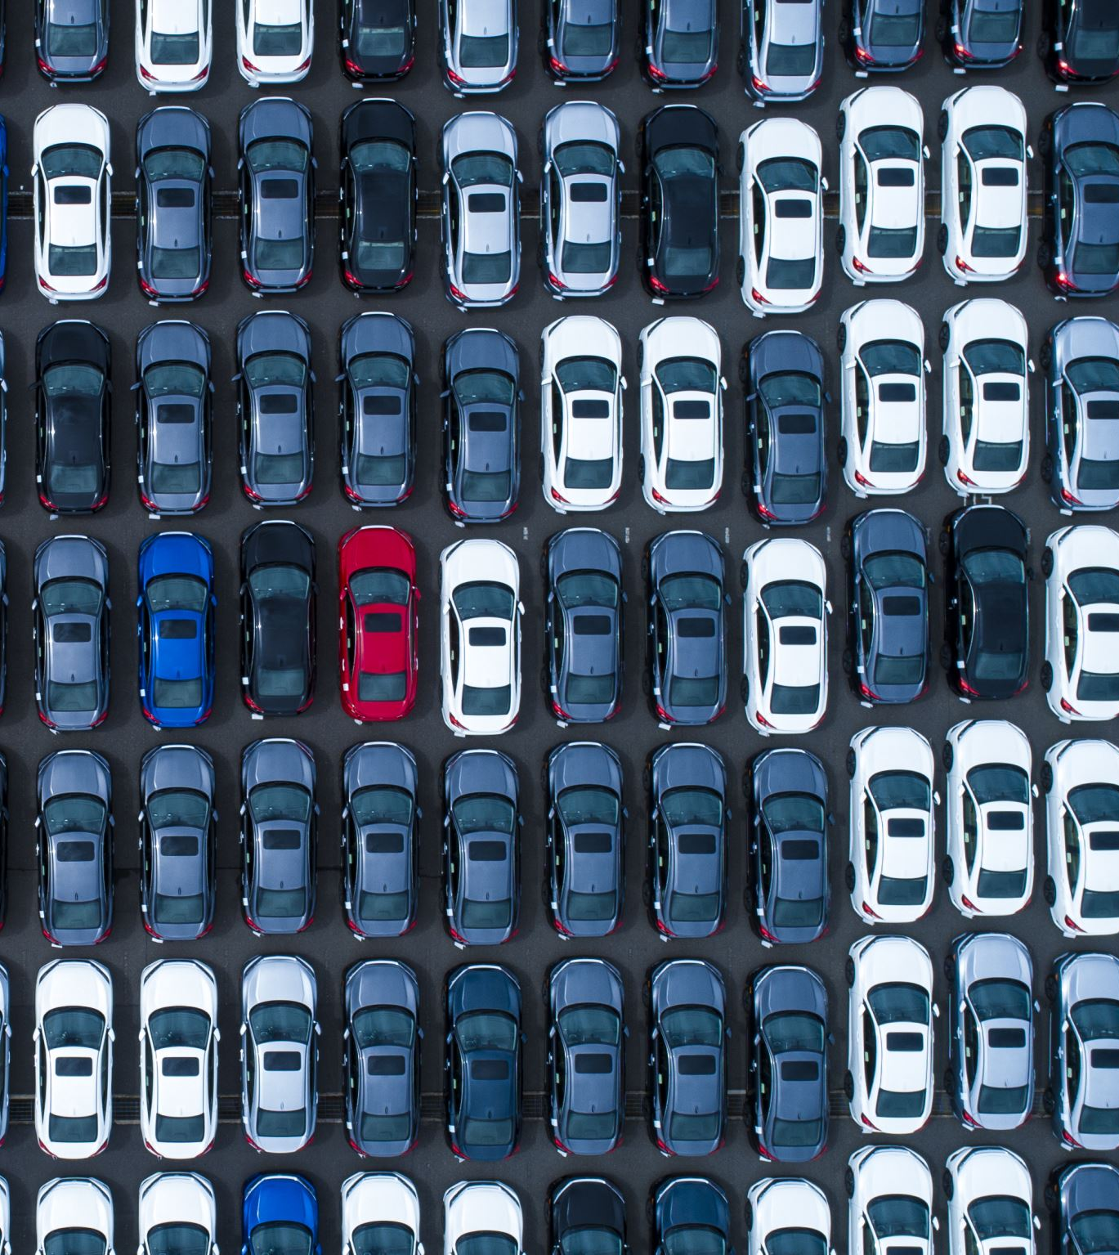
Continue
Insights:- The insights that can be derived from analyzing the distribution of car prices by brand and body style are Price range variation ,Price disparities , Premium brands or body styles , Value-oriented brands or body styles and Competitive analysis.
Result:- distribution of car prices

Slide 22
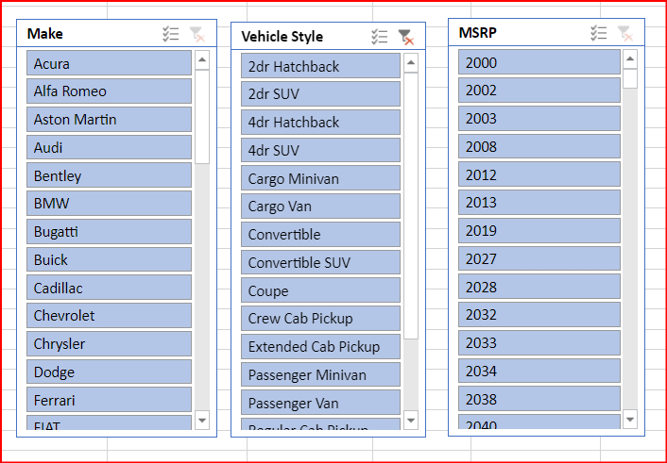
These are the slicers which have occurred by selecting the graph and then using the slicers

Slide 23

Task 2: Which car brands have the highest and lowest average MSRPs, and how does this vary by body style?
Project Description:- The task is given to find Which car brands have the highest and lowest average MSRPs, and how does this vary by body style?
Approach:- I have taken make in the axis column and average of msrp in the values and vehicle style in the legend. Now , by using this data I have founded the graph .
Tech stack used:- I have used Ms office 365/ google sheets to perform the operation.

Slide 24
Continue
InsightsThe insights that can be derived from analyzing the average MSRPs by car brand and body style are Brands with highest average MSRPs , Brands with lowest average MSRPs , Variation of MSRPs by body style within brands and Customer preferences and price sensitivity.
Result:- Average msrp and body styles (sheet link)

Slide 26
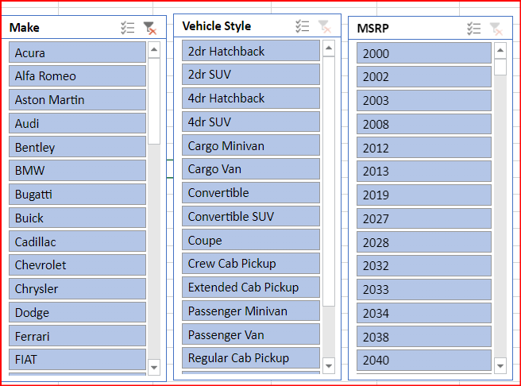
These are the slicers which have occurred by selecting the graph and then using the slicers

Slide 27
Task 3: How do the different feature such as transmission type affect the MSRP, and how does this vary by body style?
Project Description:- The task is given to find How do the different feature such as transmission type affect the MSRP, and how does this vary by body style.
Approach:- I have taken the two columns transmission type and msrp from the data set with the help of those two columns . I have drawn the graph. Next they asked to find the AVERAGE MSRP FOR EACH COMBINATION OF TRANSMISSION TYPE AND BODY STYLE . For that I have created another pivot table transmission type in the columns , vehicle style in rows and average msrp in values.

Slide 28
Continue
Tech stack used:- I have used Ms office 365/ google sheets to perform the operation.
Insights:- The insights that can be derived from analyzing the impact of transmission type on the MSRP and its variation by body style are Transmission type and MSRP relationship ,Price variation within body styles ,Value proposition by transmission type ,Consideration of other factors ,Competitive analysis ,Consumer preferences and buying behavior.
Result:- transmission type (sheet link)

Slide 29
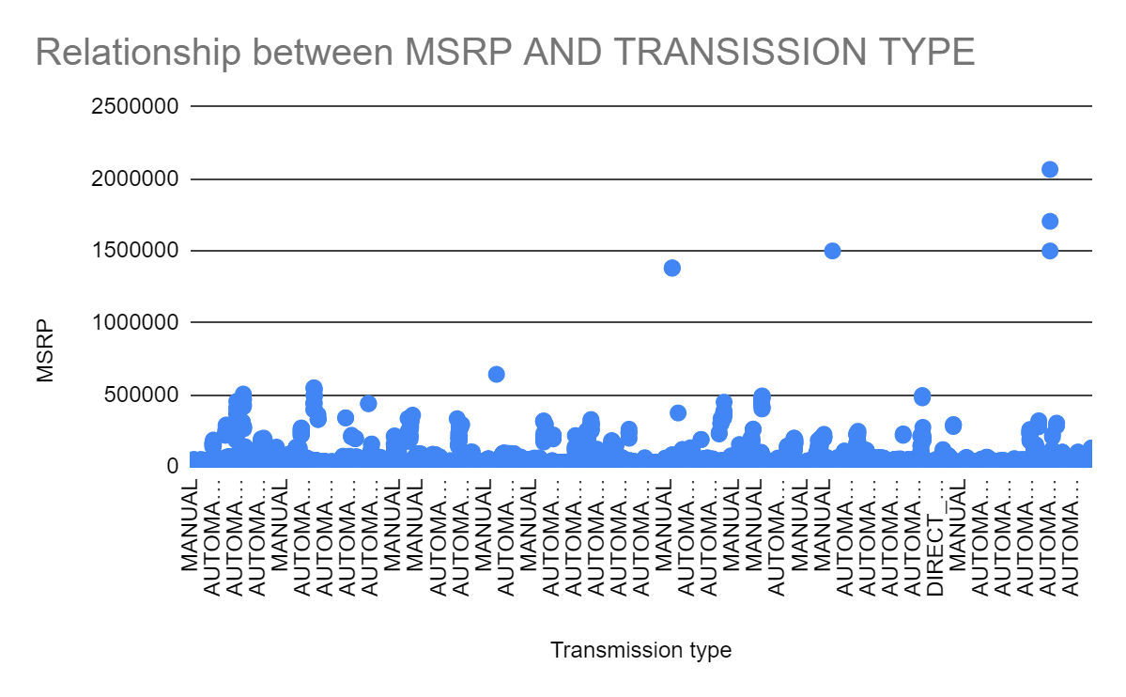

Slide 30
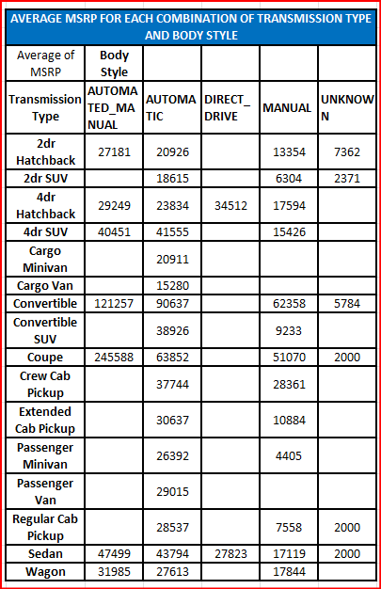

Slide 31

Task 4: How does the fuel efficiency of cars vary across different body styles and model years?
Project Description:- The task is given to find How does the fuel efficiency of cars vary across different body styles and model years
Approach:- To complete the task I used the the pivot table with the help of pivot table years in rows and average of highway mpg in the values and the graph is drawn. And also they asked to find out the a AVERAGE MSRP FOR EACH COMBINATION OF BODY STYLE AND MODEL YEAR again by using the pivot table I have created it.
Tech stack used:- I have used Ms office 365/ google sheets to perform the operation.

Slide 32
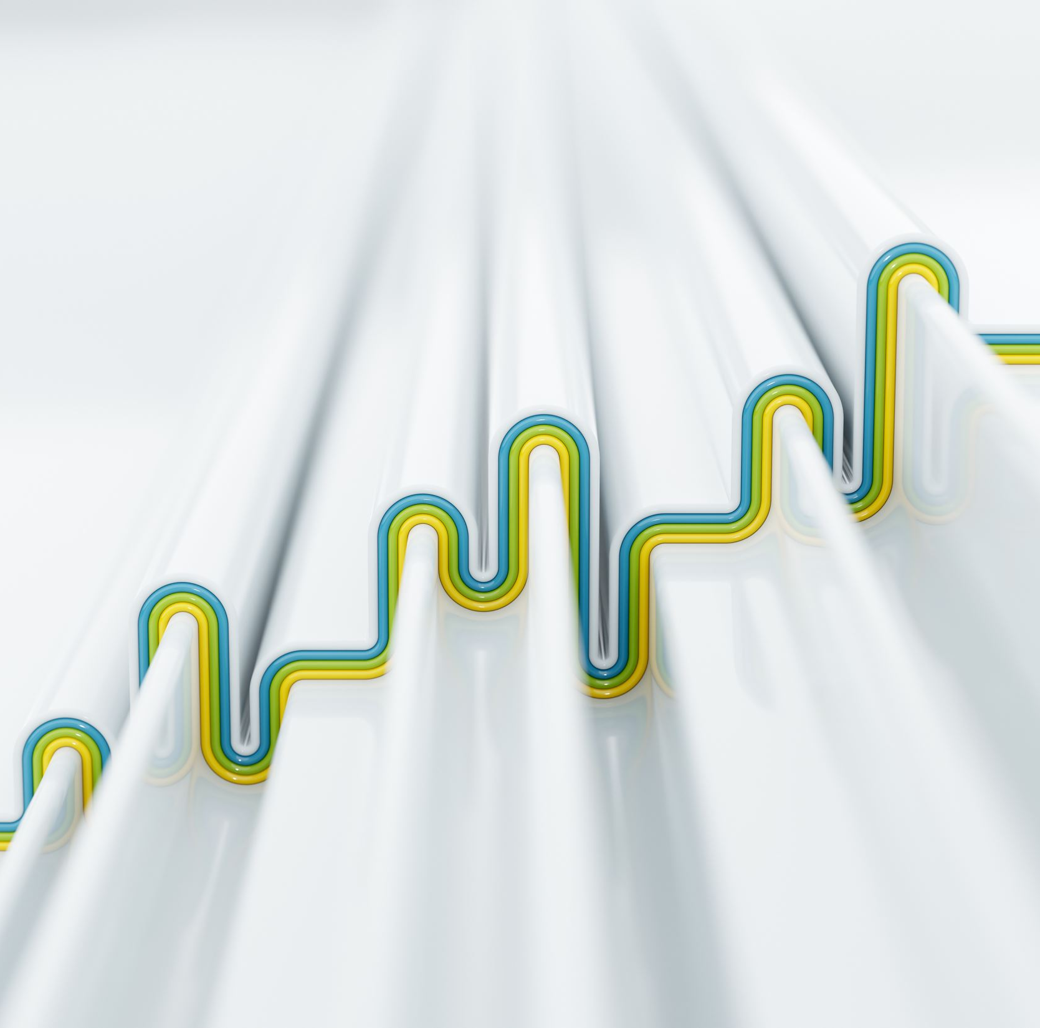
Continue
Insights:- The insights that can be derived from analyzing the fuel efficiency variations of cars across different body styles and model years are Body style impact on fuel efficiency ,Fuel efficiency trends by model year ,Comparison of fuel efficiency between body styles ,Interaction between body style and model year ,Impact of technological advancements and Consumer preferences and market trends.
Result:- fuel efficiency (sheet link)

Slide 33
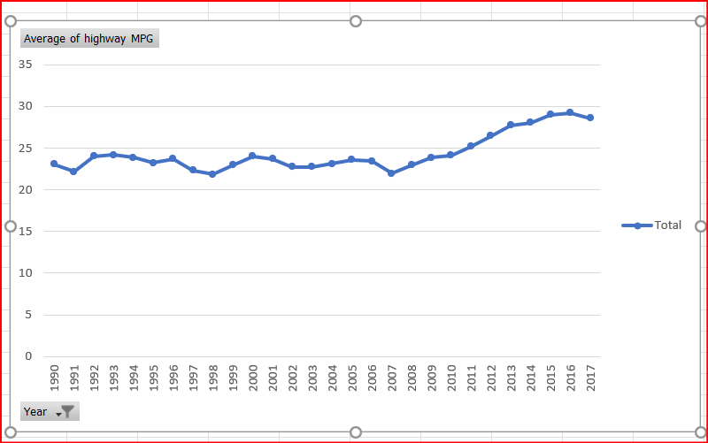

Slide 34
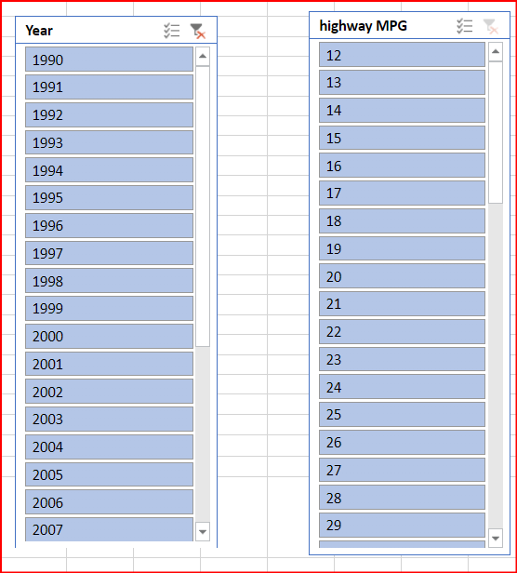

Slide 35
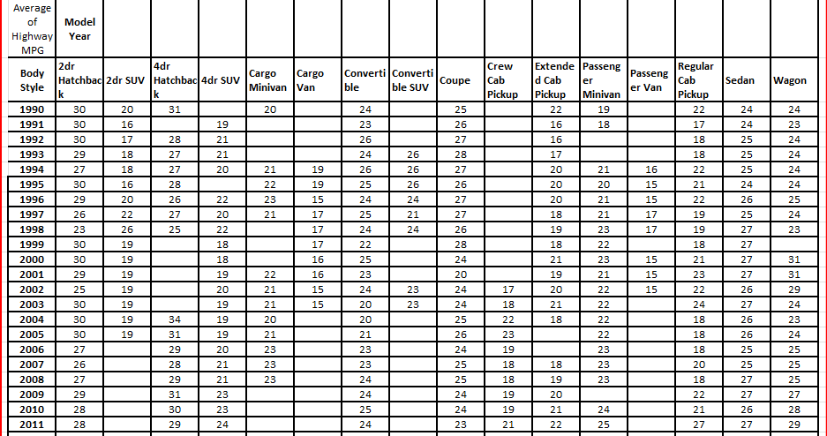

Slide 37

Task 5: How does the car's horsepower, MPG, and price vary across different Brands?
Project description:- The task is given to find How does the car's horsepower, MPG, and price vary across different Brands.
Approach:- By using the pivot table I have taken 4 columns make, average of engine hp ,average of highway mpg and average of msrp by taking all these 4 columns drawn a bubble chart.
Tech stack used:- I have used Ms office 365/ google sheets to perform the operation.
Insights:- The insights that can be derived from analyzing the variations in car's horsepower, MPG, and price across different brands are Brand-specific performance , Fuel efficiency by brand , Price positioning , Brand consistency and Market segmentation.
Result:- Relational analysis (sheet link)

Slide 38
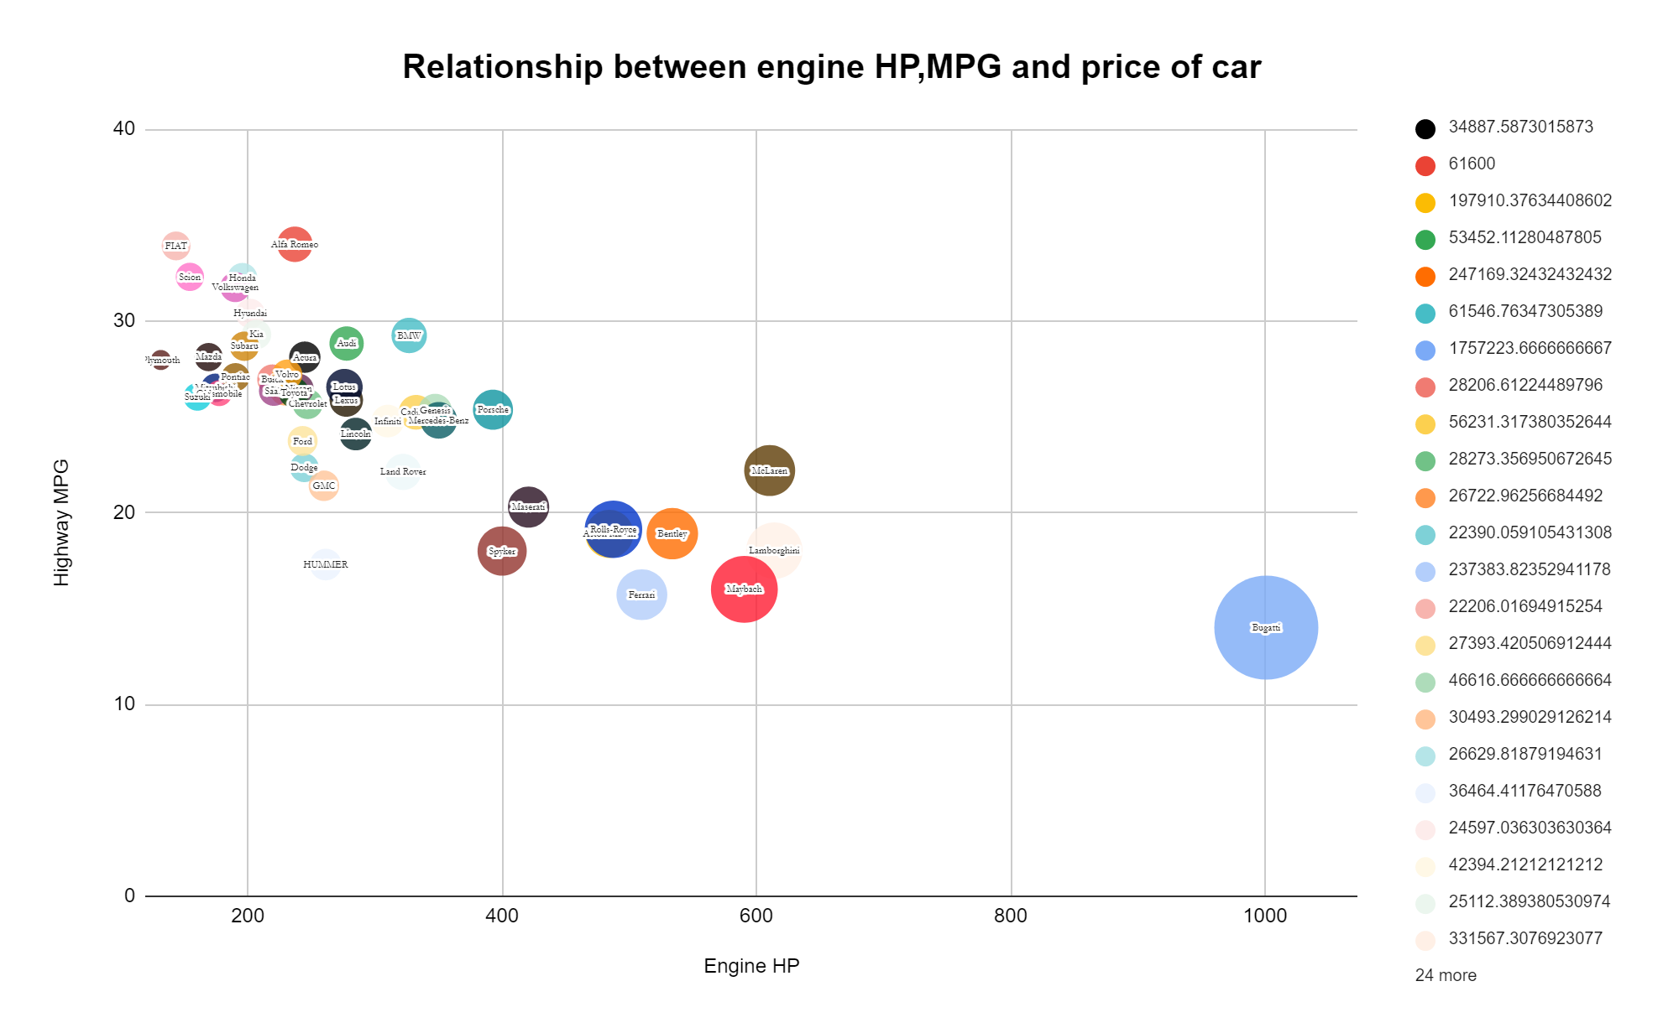

Slide 39
Google sheet link:- Sheet drive link :- analysis

Slide 40

THANK YOU

